Slide 1

GROUP – 10 Data-Driven Insights into Employee Attrition, Salaries, and Performance Ratings
Department of Health Informatics IU Luddy School of Informatics, Computing & Engineering
Team Members: Professor:
Gopi Krishna Boppana Dr. Zeyana Hamid, PhD
Radhika Gedela
Krishna Vamsi Gottipati
Akhila Siri Godana
Elisha Yallamati

Slide 2
INTRODUCTION
In the dynamic realm of organizational management, the interconnected factors of employee attrition, salaries, and performance ratings are pivotal for the success and longevity of enterprises.
Understanding the intricate dynamics is essential for fostering a thriving work environment. Job satisfaction stands out as a cornerstone for both employee retention and heightened performance, emphasizing the significance of individuals finding purpose in their roles (Zhenjing et al., 2022, pp. 1,2).
The delicate balance of work-life equilibrium, including flexible schedules and supportive policies, plays a crucial role in ensuring employee well-being and sustained commitment (Alblihed & Alzghaibi, 2022, p. 2).
Competitive and fair compensation structures are foundational, with perceived commensurability driving employee retention (Balushi et al., 2022, p. 2).

Slide 3
RQ & Hypothesis
Multiple linear regression
What factors significantly determine employee salaries in the company, and how well can we predict salaries using variables like years of experience, education level, job level, and department?
Null Hypothesis (H0): There is no significant relationship between employee salaries and variables such as years of experience, education level, job level, and department.
Alternative Hypothesis (H1): There is a significant relationship between employee salaries and variables such as years of experience, education level, job level, and department, allowing us to predict salaries effectively.
Logistic Regression
How do demographic and job-related factors (age, gender, job level, department, job satisfaction) collectively impact employee attrition, and can we build an accurate predictive model for it?
Null Hypothesis (H0): There is no significant relationship between demographics, job-related factors (age, gender, job level, department, job satisfaction) and employee attrition within the company.
Alternative Hypothesis (H1): There is a significant relationship between demographics, job-related factors (age, gender, job level, department, job satisfaction) and employee attrition within the company.
Notes:
impact employee attrition and performance rating
predictors and responese vairiable

Slide 4
RQ & Hypothesis
Ordinary regression analysis
How do factors like environment satisfaction, job satisfaction, relationship satisfaction, and work-life balance affect the likelihood of achieving higher performance ratings, and can we create an accurate predictive model for performance ratings?
Null Hypotheses (H0): There is no significant relationship between environment satisfaction, job satisfaction, relationship satisfaction, work-life balance, and performance ratings.
Alternative Hypotheses (H1): There is a significant relationship between at least one of the factors (environment satisfaction, job satisfaction, relationship satisfaction, work-life balance) and performance ratings.
Notes:
predictors and response variable

Slide 5

Dataset
The analysis is based on employee attrition in a corporate setting, where various factors affecting employee turnover are explored.
The dataset, sourced from Kaggle's Employee Attrition dataset by Prashant Patel, consists of 1470 observations and 28 variables.
The dataset enables an in-depth exploration of factors influencing employee attrition, with variables covering personal demographics, job-related information, and overall job satisfaction. The analysis seeks to uncover patterns and insights into why employees may leave an organization, considering a wide range of factors.

Slide 6
Variables
Categorical Variables |  | Numerical Variables
Ordinal | Nominal | Continuous | Discrete
Education EnvironmentSatisfaction JobInvolvement JobSatisfaction PerformanceRating RelationshipSatisfaction WorkLifeBalance | Attrition BusinessTravel Department EducationField Gender JobRole MaritalStatus Over18 OverTime | Age MonthlyIncome | DistanceFromHome Education EnvironmentSatisfaction JobInvolvement JobLevel JobSatisfaction NumCompaniesWorked PercentSalaryHike PerformanceRating RelationshipSatisfaction TotalWorkingYears TrainingTimesLastYear WorkLifeBalance YearsAtCompany YearsInCurrentRole YearsSinceLastPromotion YearsWithCurrManager

Slide 7
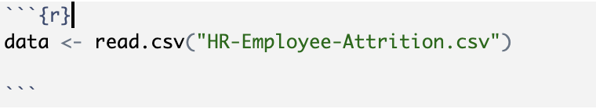
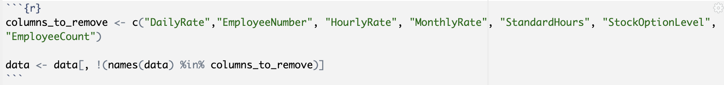
Data Importing
The CSV file containing employee attrition data was uploaded to R using the "read.csv" code.
Following the dataset upload, we opted to eliminate unnecessary columns based on our objectives, accomplishing this task with the assistance of:

Slide 8
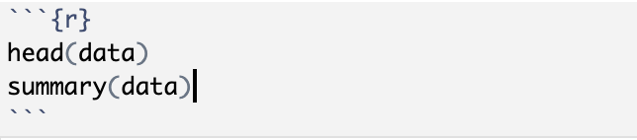
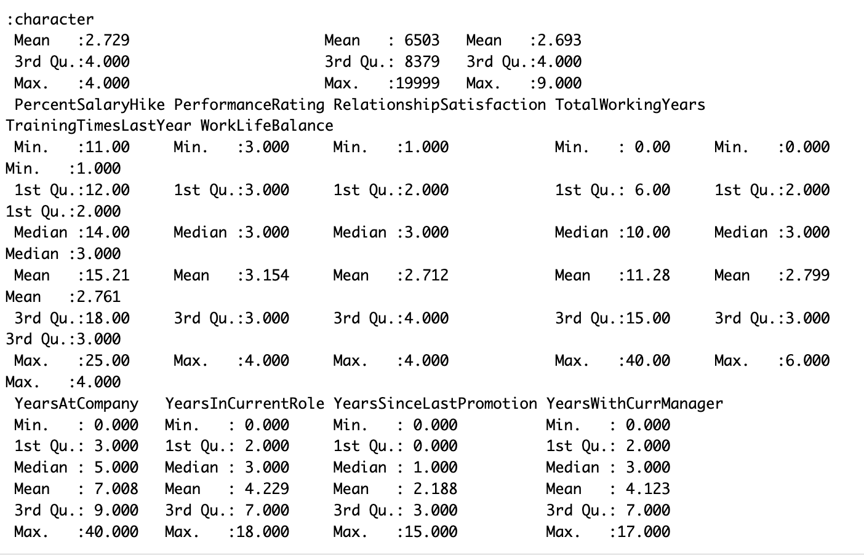
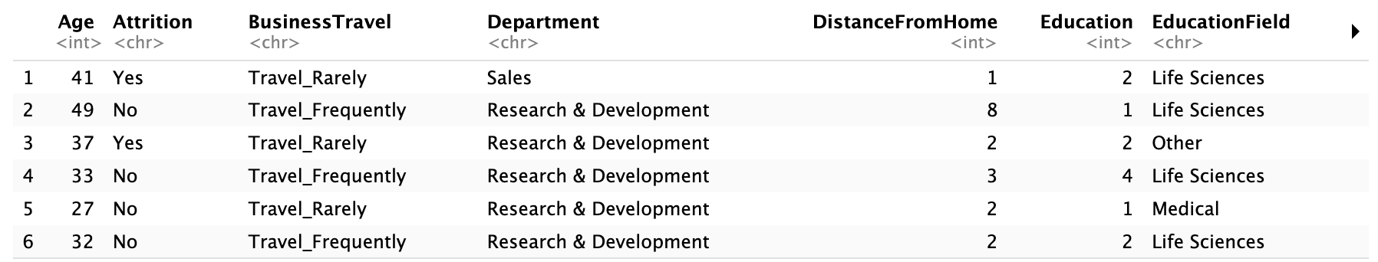
Data Description
We examined the first few rows of the modified dataset with the command "head(data)" and obtained a summary of the dataset using "summary(data).”

Slide 9
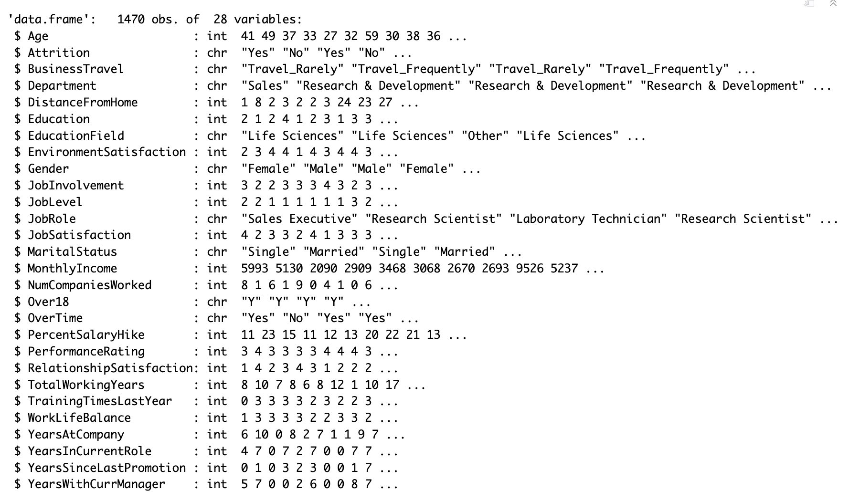
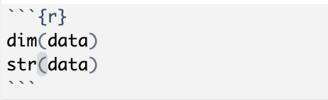
Data Description
We explored the dimensions of the dataset using "dim(data)," revealing the number of rows and columns. Additionally, we examined the structure of the dataset with "str(data)," obtaining information about the variable types and their respective attributes.

Slide 10
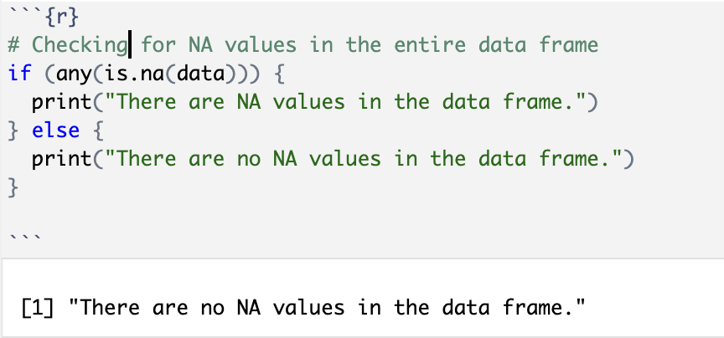
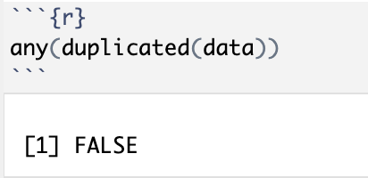
Data Cleaning
We examined the dataset for null values, and the findings reveal an absence of any null entries in our data.
We conducted a search for duplicate values in our dataset and determined that there were none present.

Slide 11
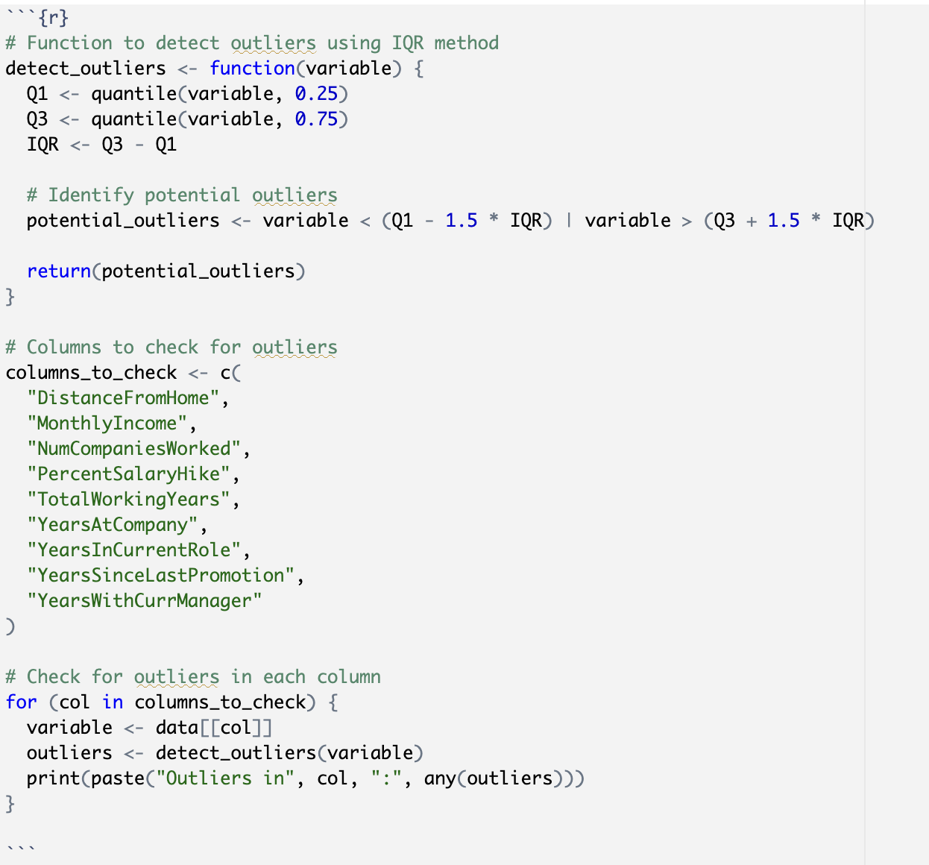
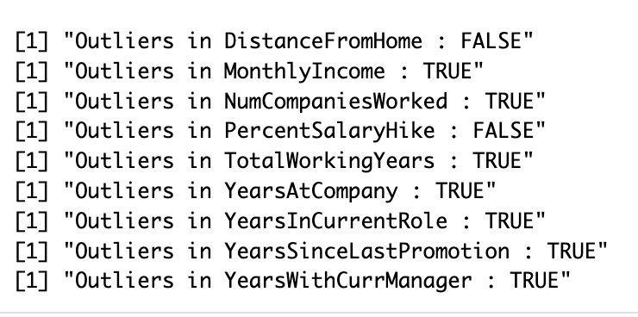
Data Cleaning
The subsequent step involves examining for outliers. We conducted an inspection for outliers using the Interquartile Range (IQR) method.

Slide 12
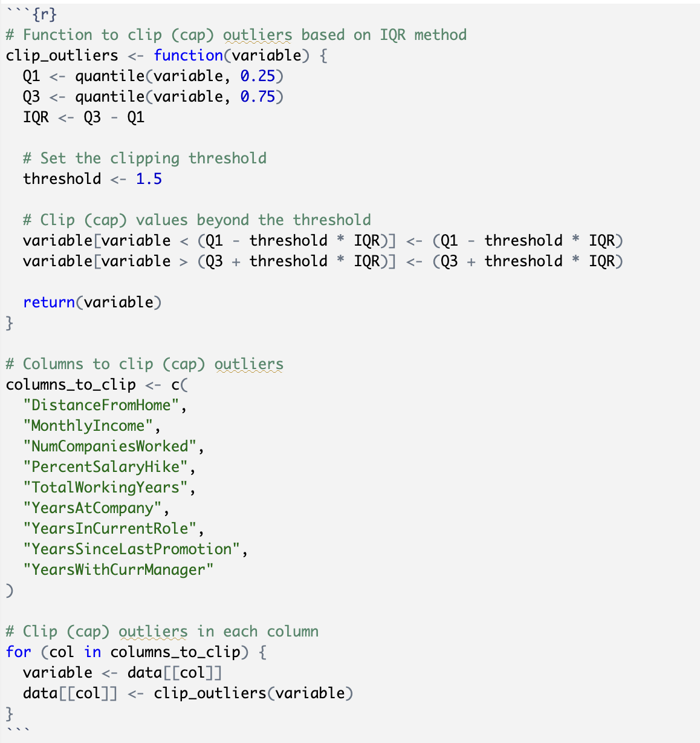
Data Cleaning
We opted to address outliers in the dataset through the application of the Winsorization technique, employing the clipping method.

Slide 13
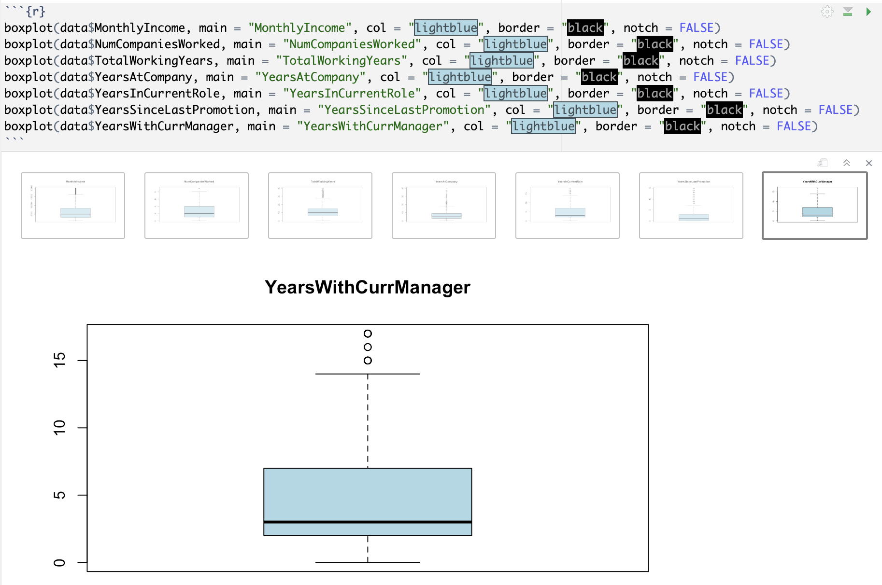
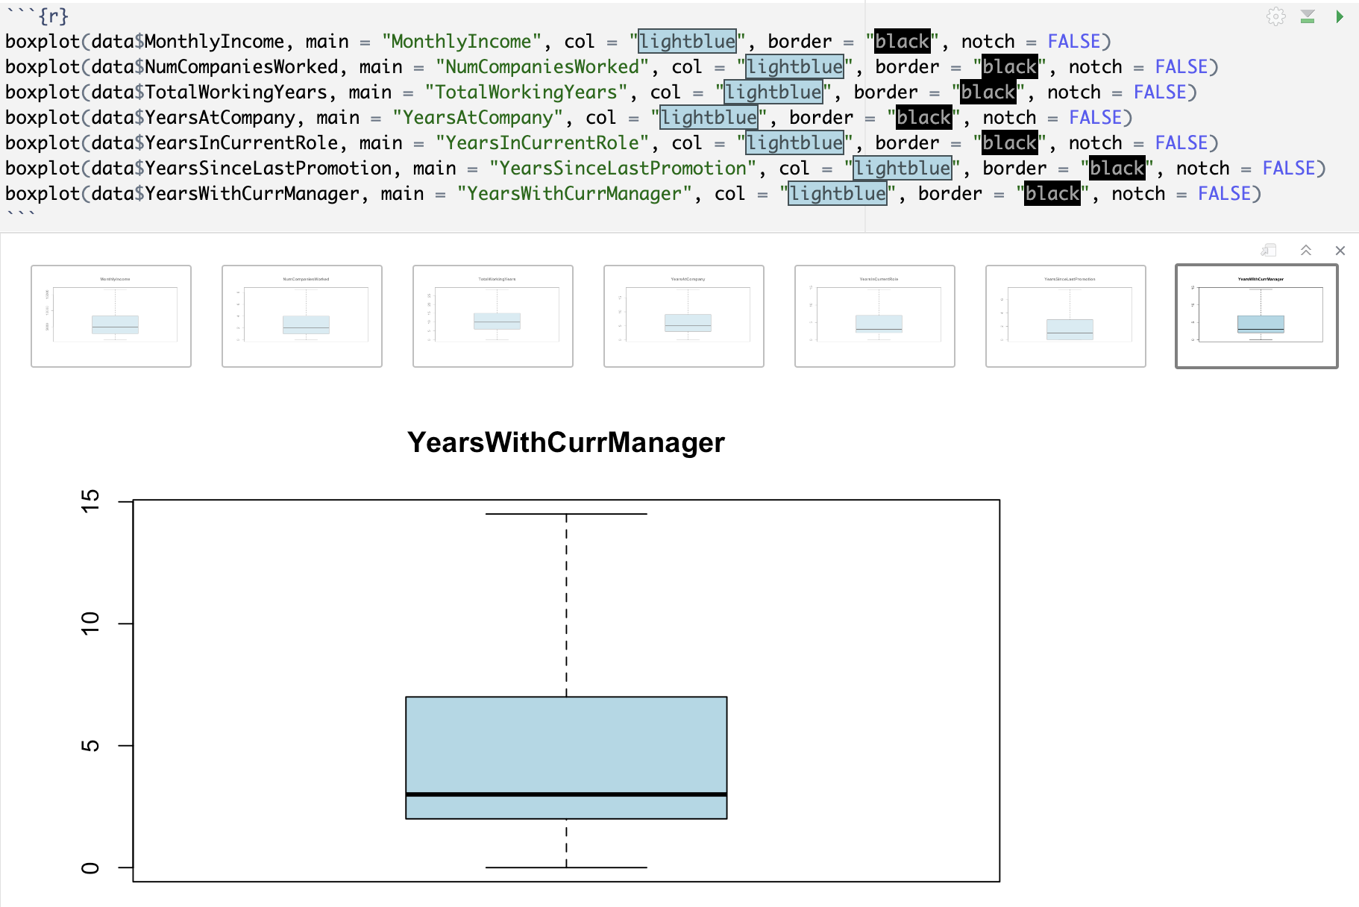
Data Cleaning
We employed a box plot to illustrate the presence of outliers. Subsequently, we utilized the interquartile range to eliminate these outliers, aiming to enhance the dataset's distribution and improve the model's performance.

Slide 14
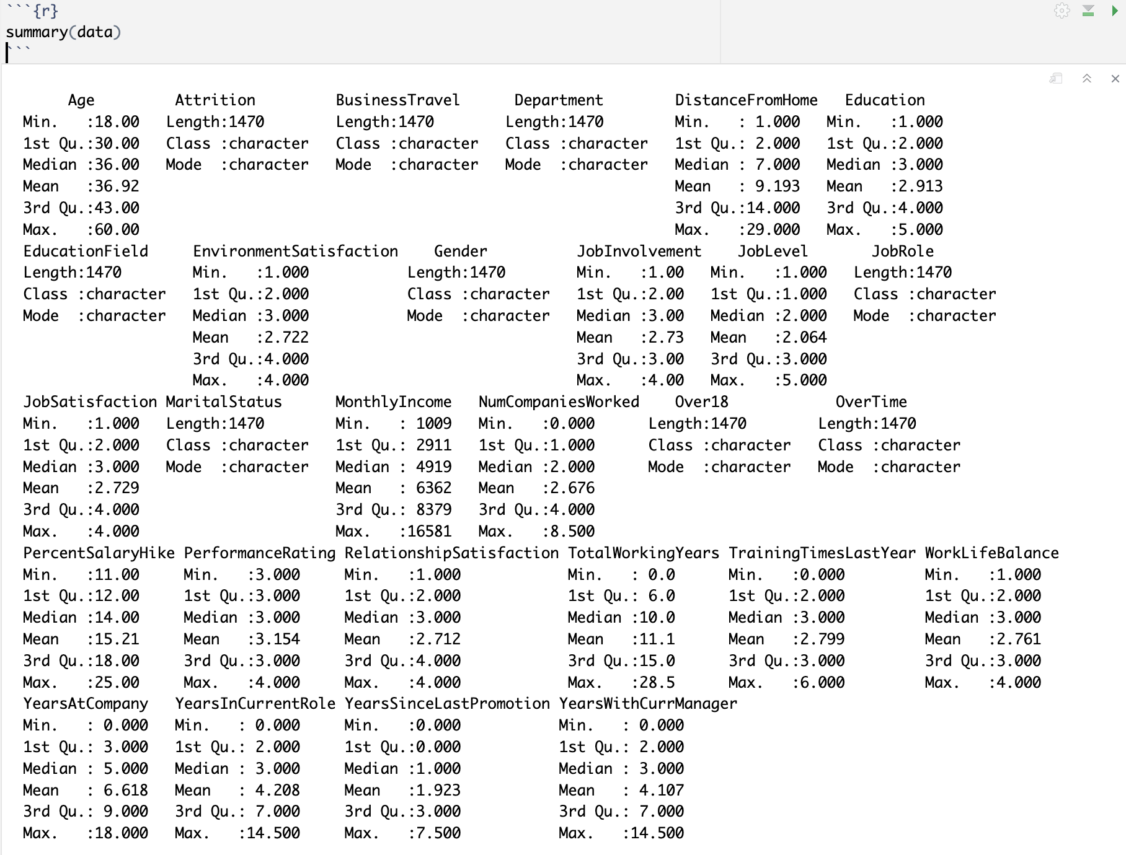
Exploratory Data Analysis
Summary statistics
We conducted a comprehensive analysis of summary statistics, delving into various metrics such as mean, median, and other relevant measures. This exploration provided a detailed insight into the central tendencies and distribution characteristics of the dataset.

Slide 15
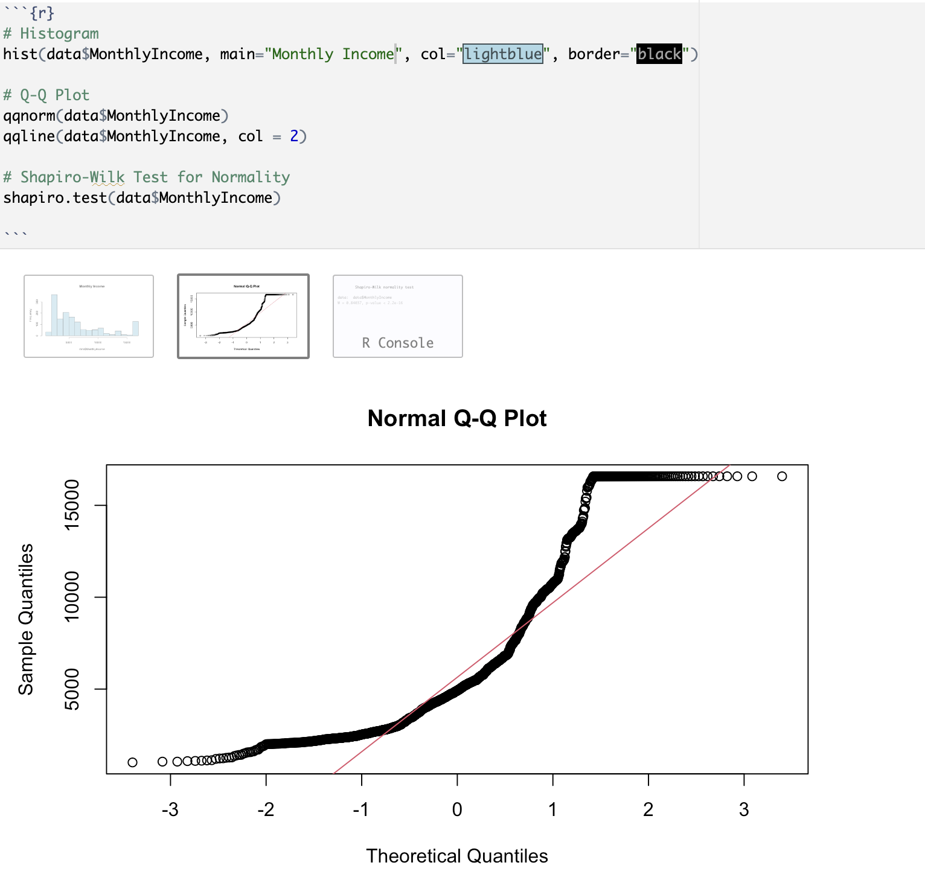
Checking for Normality
We conducted a normality assessment using a combination of a histogram, Q-Q plot, and the Shapiro-Wilk test to evaluate the distribution characteristics of the data and ascertain whether it adheres to a normal distribution. This plots reveals that the monthly income variable does not follow normal distribution.

Slide 16
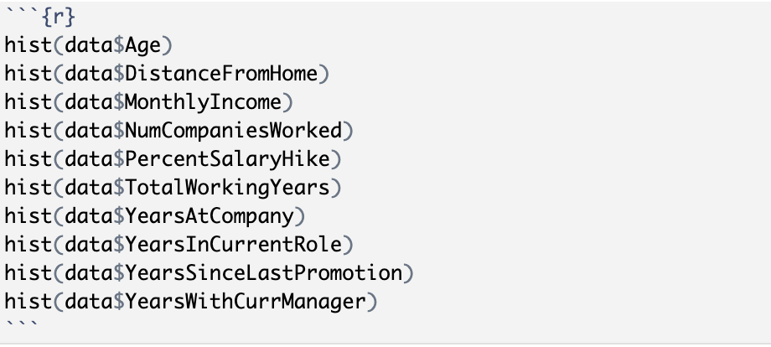
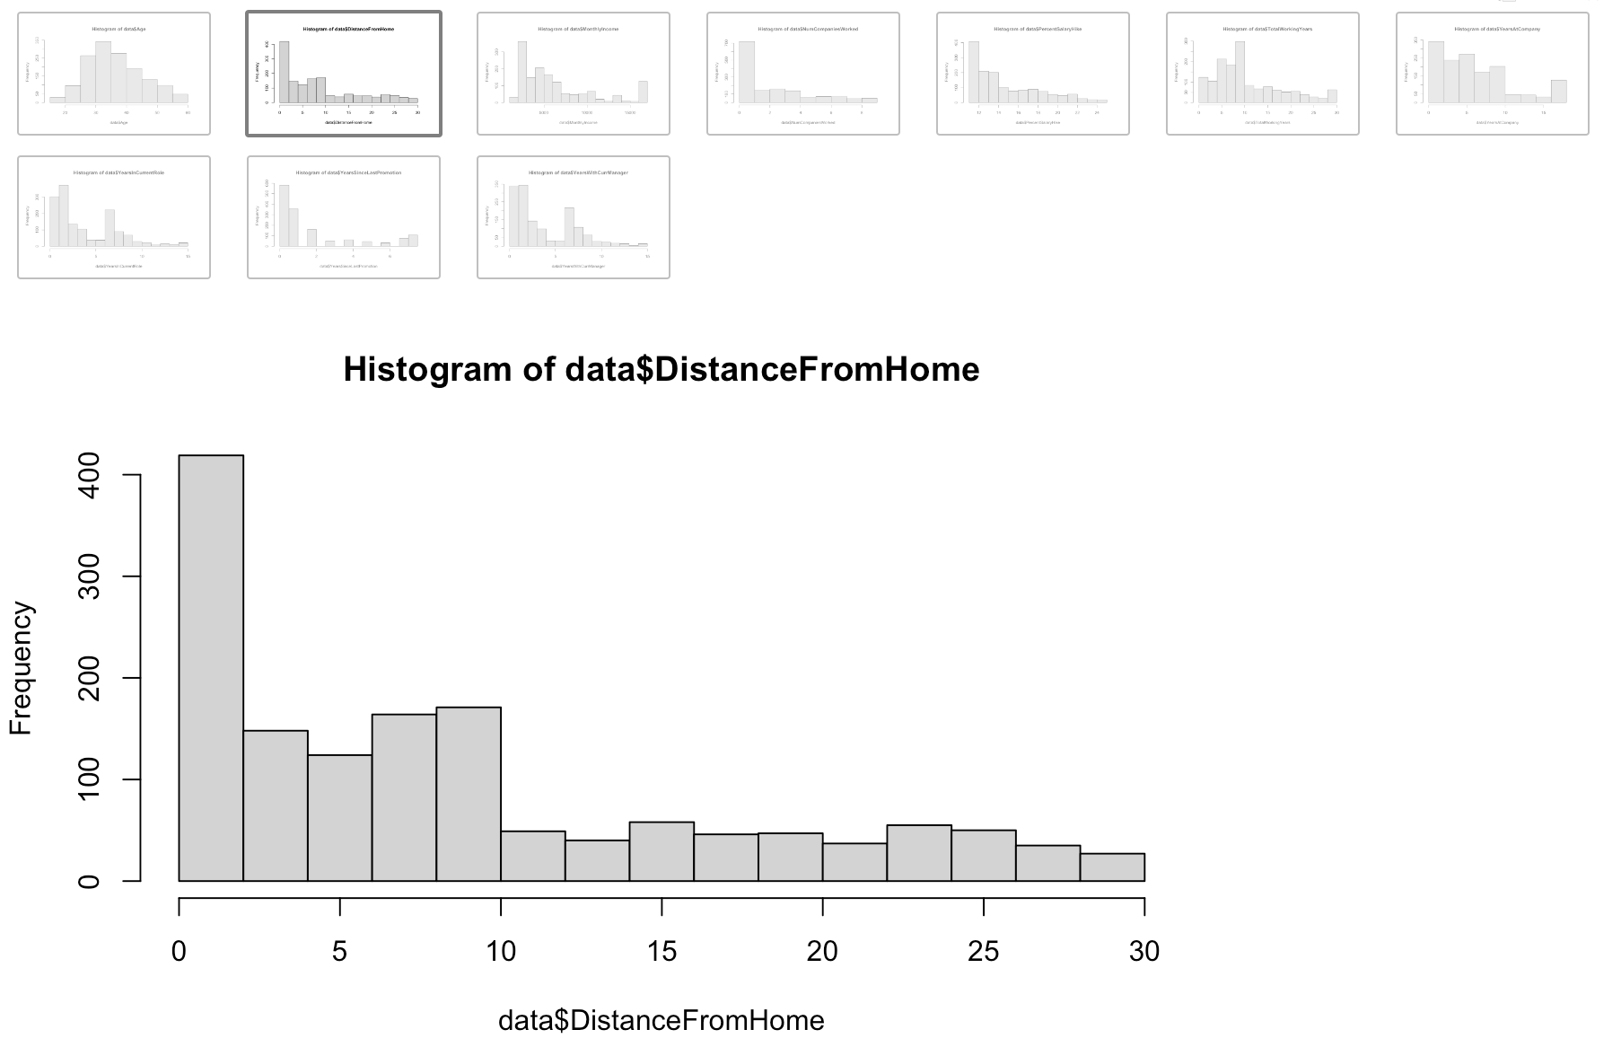
Log Transformation
Given that certain columns in the dataset do not exhibit a normal distribution, our intention is to execute a log transformation on these variables. This transformation aims to render the variables more closely aligned with a normal distribution.
The histograms presented depict the before and after the log transformation of certain columns in the dataset.

Slide 17
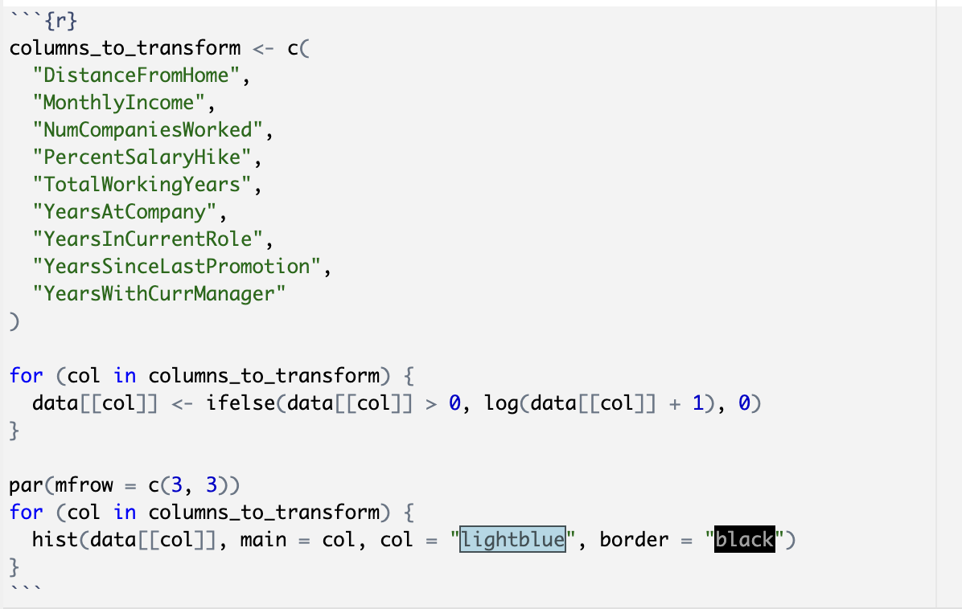
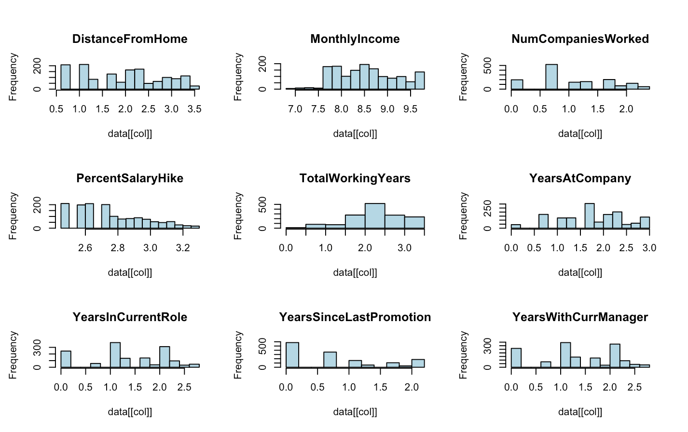
After log transformation

Slide 18
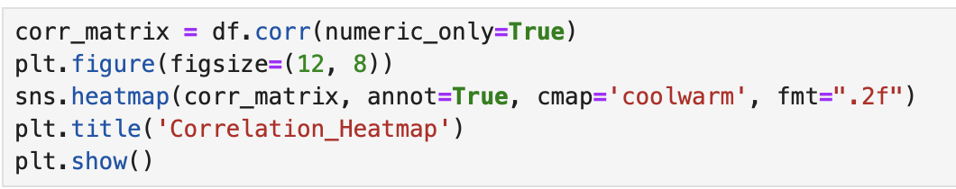
Correlation coefficient Test
We conducted a correlation test to assess the strength of association among the variables in our dataset.

Slide 19
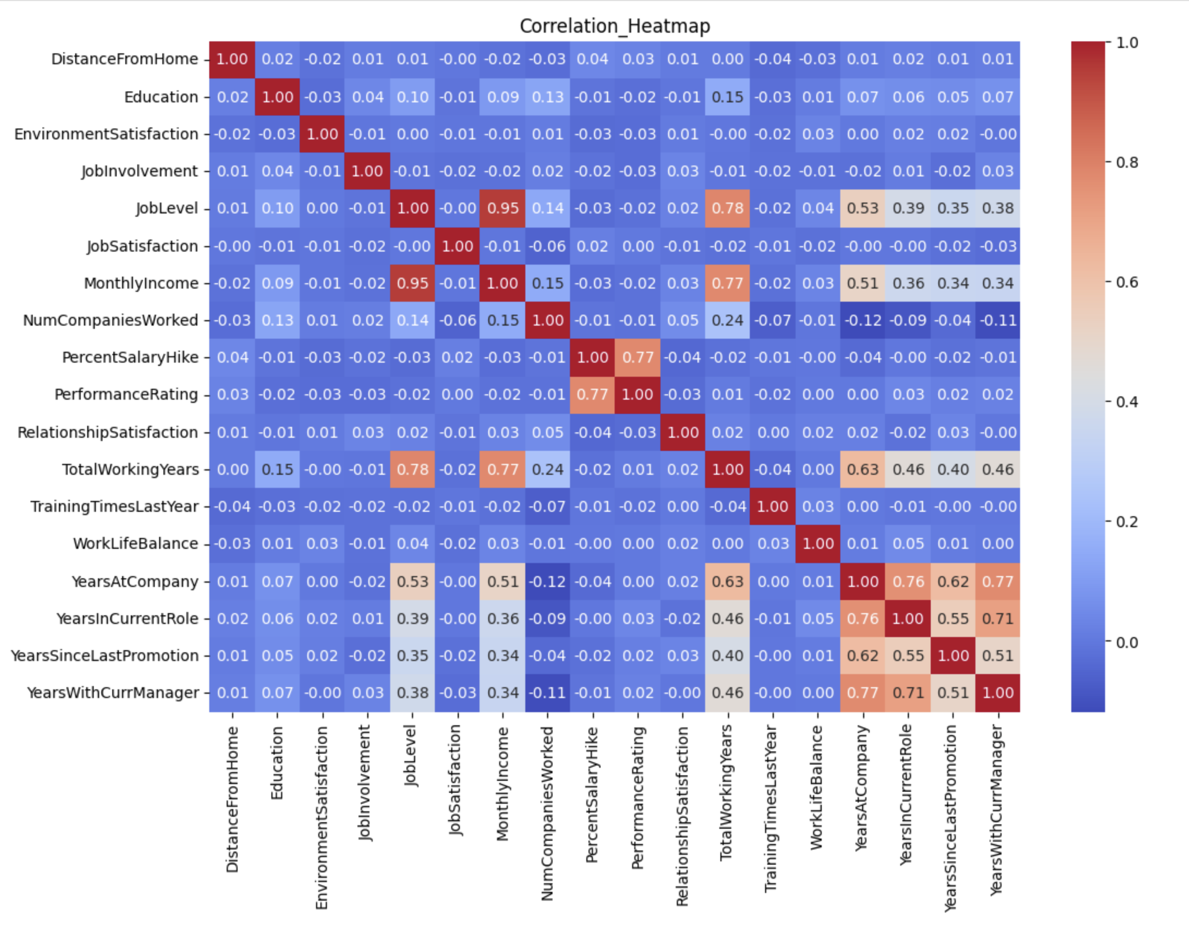
Notes:
strong positive relation - total working years with job level. performance ratings with percentage salary hike

Slide 20
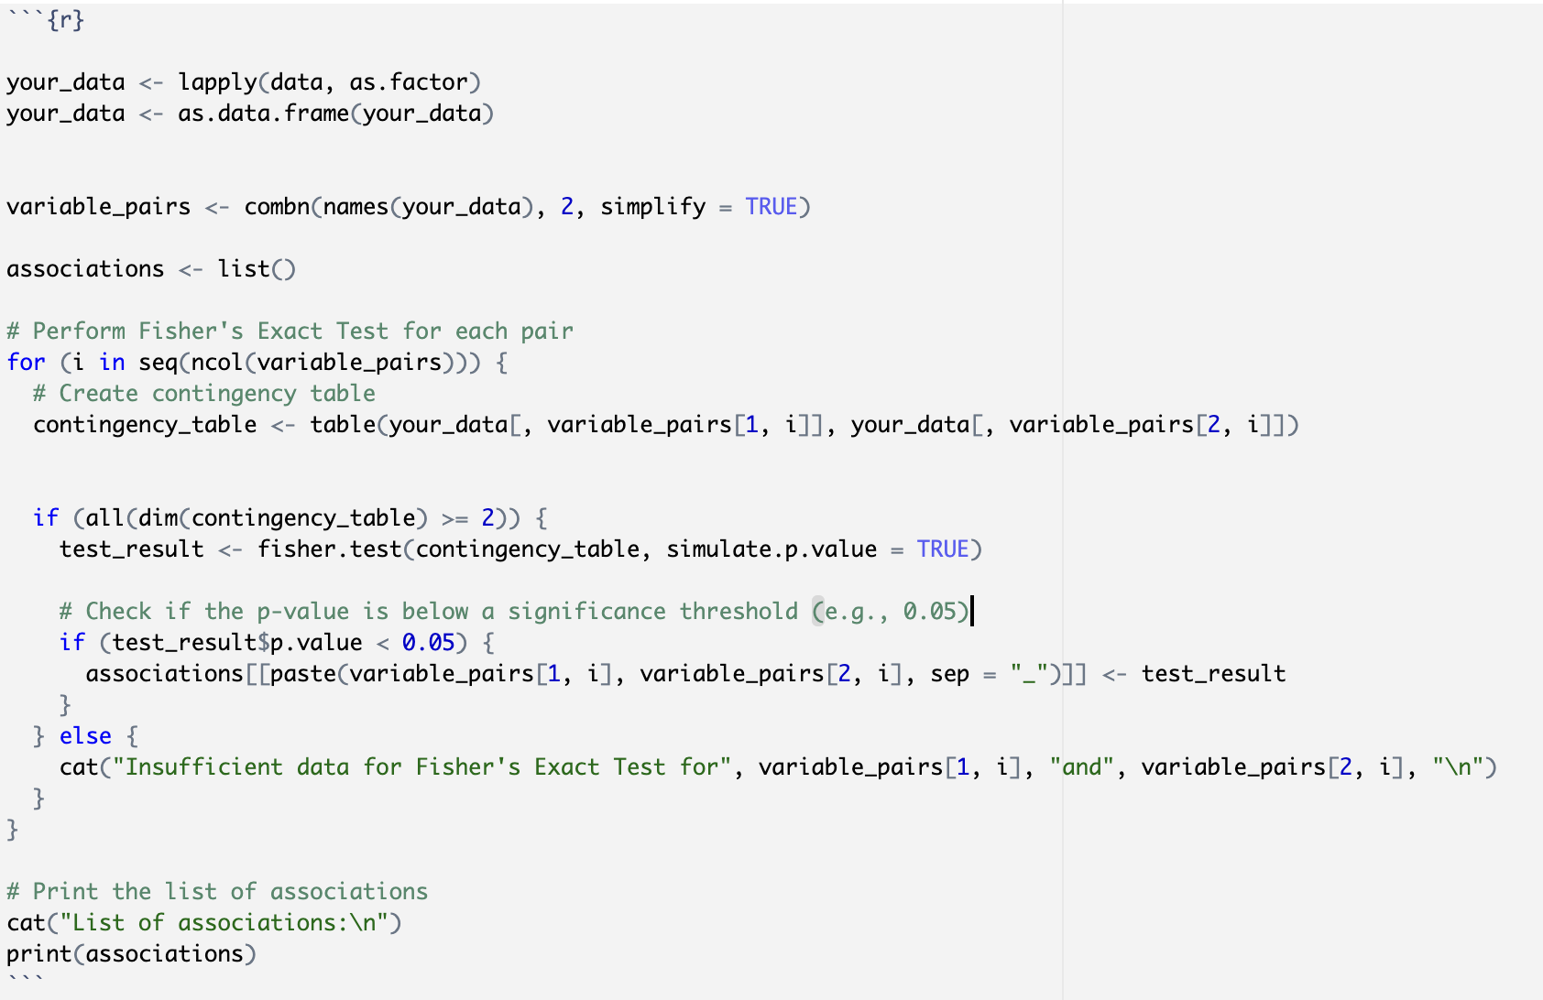
Fisher's exact test
We conducted Fisher's Exact Test to assess the association between variables.

Slide 21
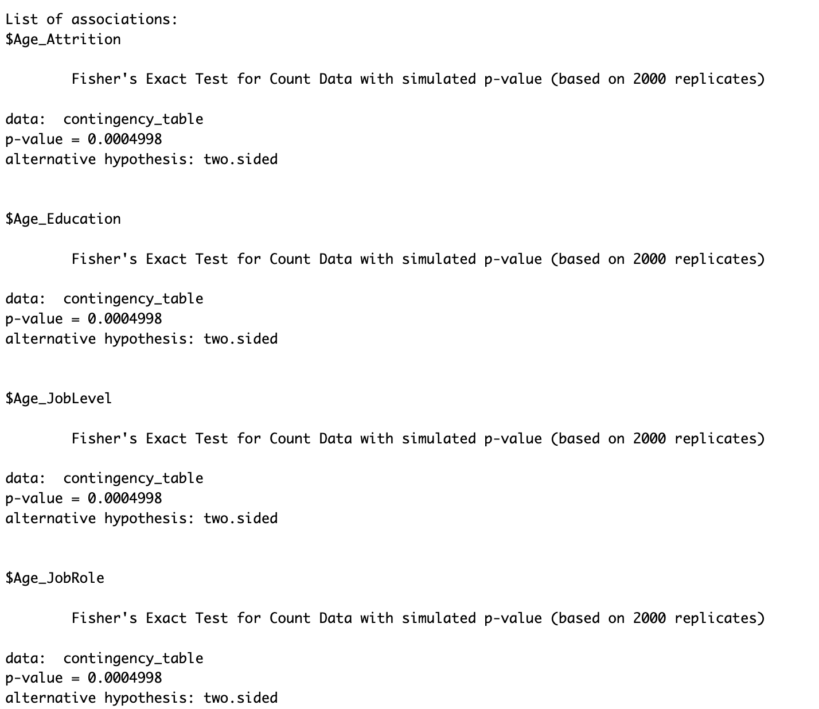
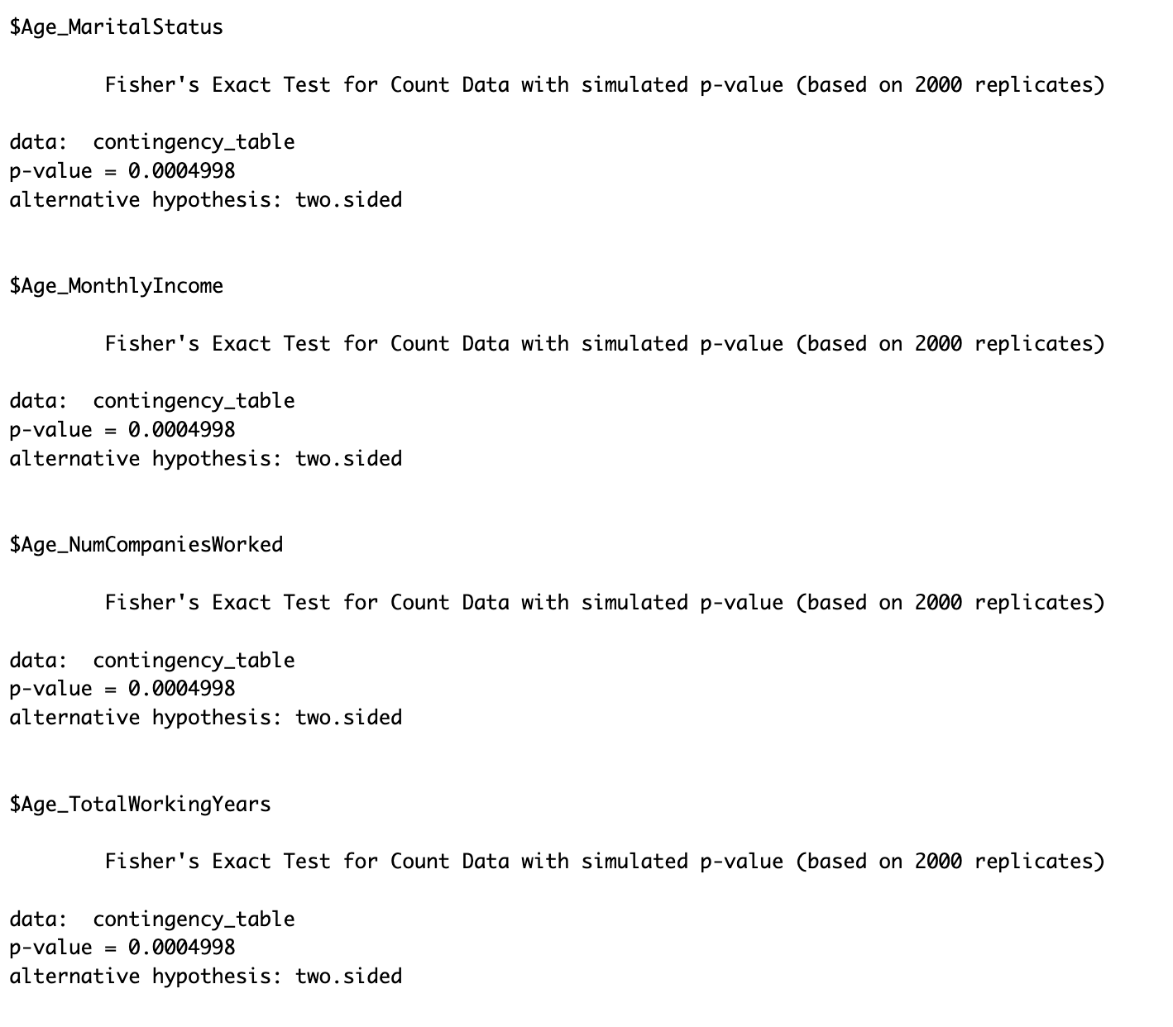

Slide 22
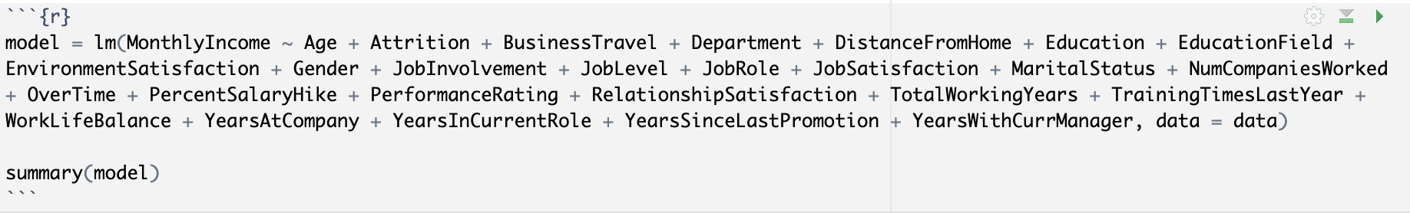
Multiple Linear Regression
In accordance with the first research question, we conducted a multiple linear regression where the monthly income serves as the response variable, and the remaining variables act as predictors.

Slide 23
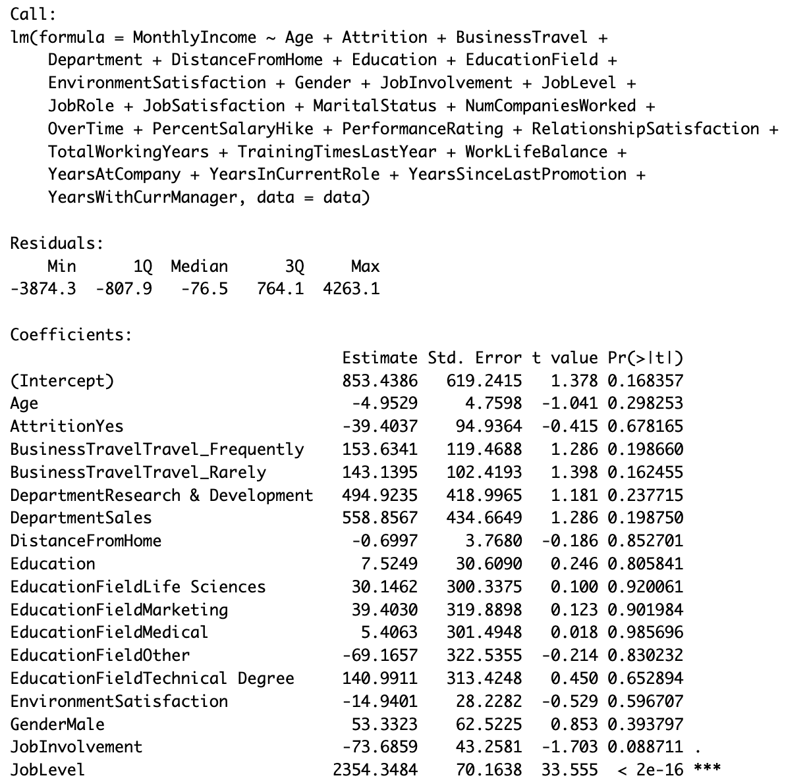
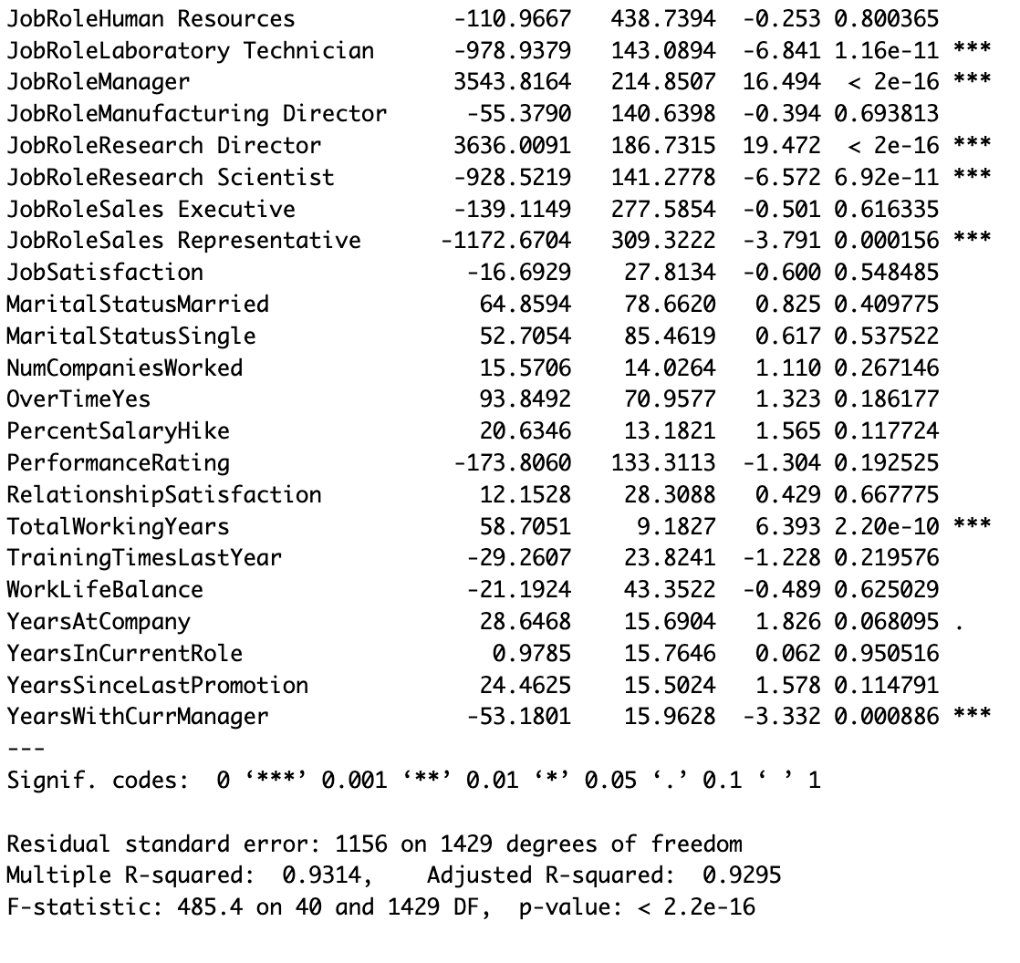
Since the p-value is below 0.05 for certain variables, we aim to select those specific variables and rerun the model to assess the R2 and adjusted R2 values.

Slide 24
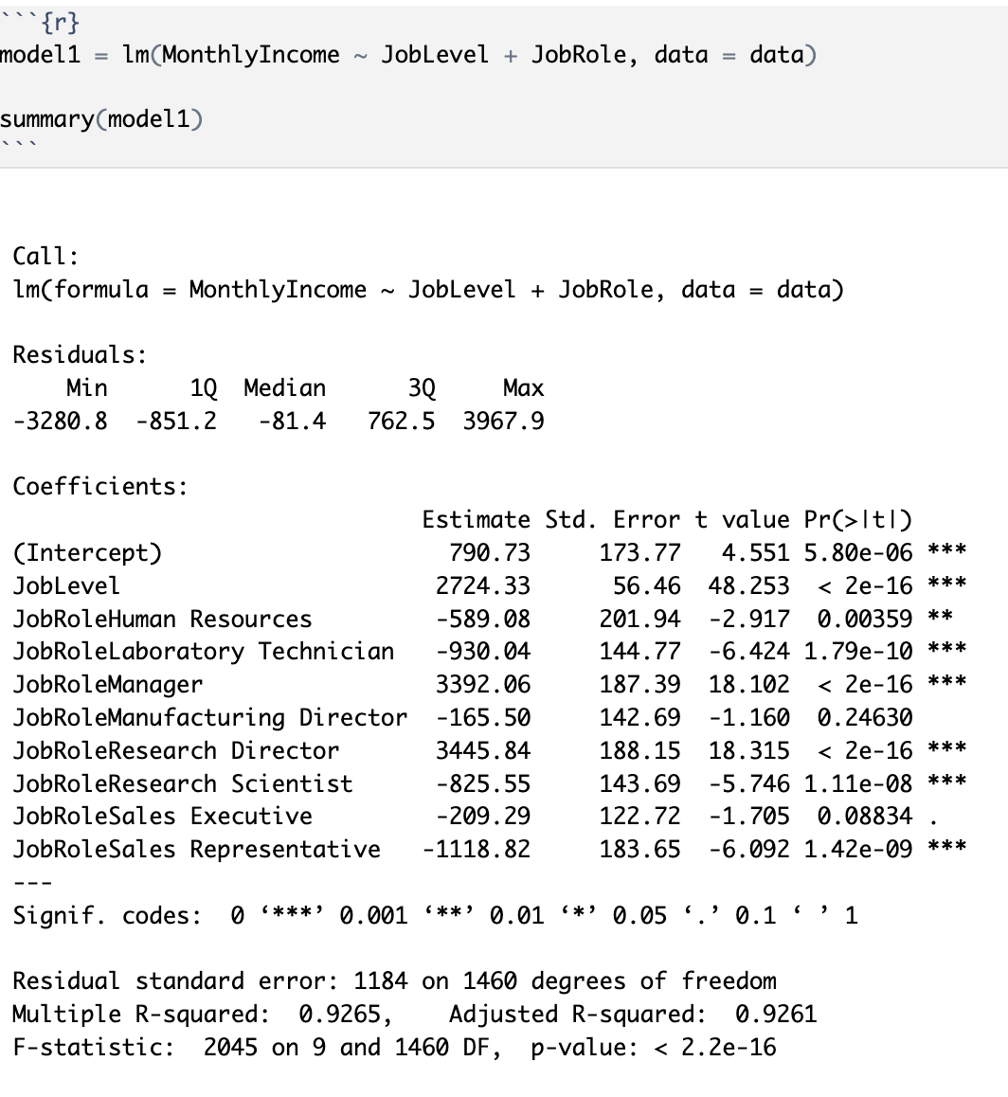
Variables that demonstrate statistical significance have been chosen, and the model is being re-executed.
With an F-statistic of 2045 and a p-value below 0.005, there is ample evidence to reject the null hypothesis. However, to enhance the strength and confidence in rejecting the null hypothesis, we conducted ANOVA and pairwise t tests to signify the associations among the variable groups.
Notes:
the variables that showed significant assocaition wwre chosen and performed the model again. R2 and adjusted same

Slide 25
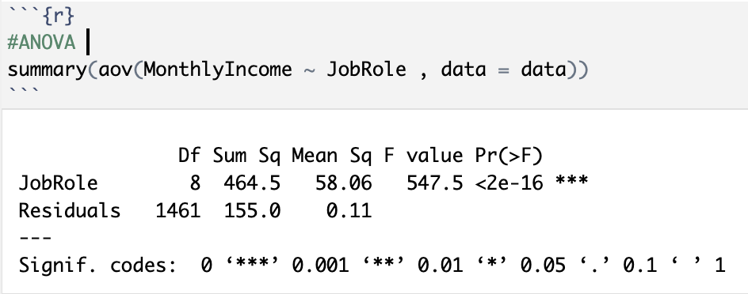
ANOVA
With a p-value below 0.05, we can confidently reject the null hypothesis, which posits that there is no significant difference among the variable groups. To delve deeper into the associations and discern specific differences between the groups, we proceeded with pairwise t-tests.

Slide 26
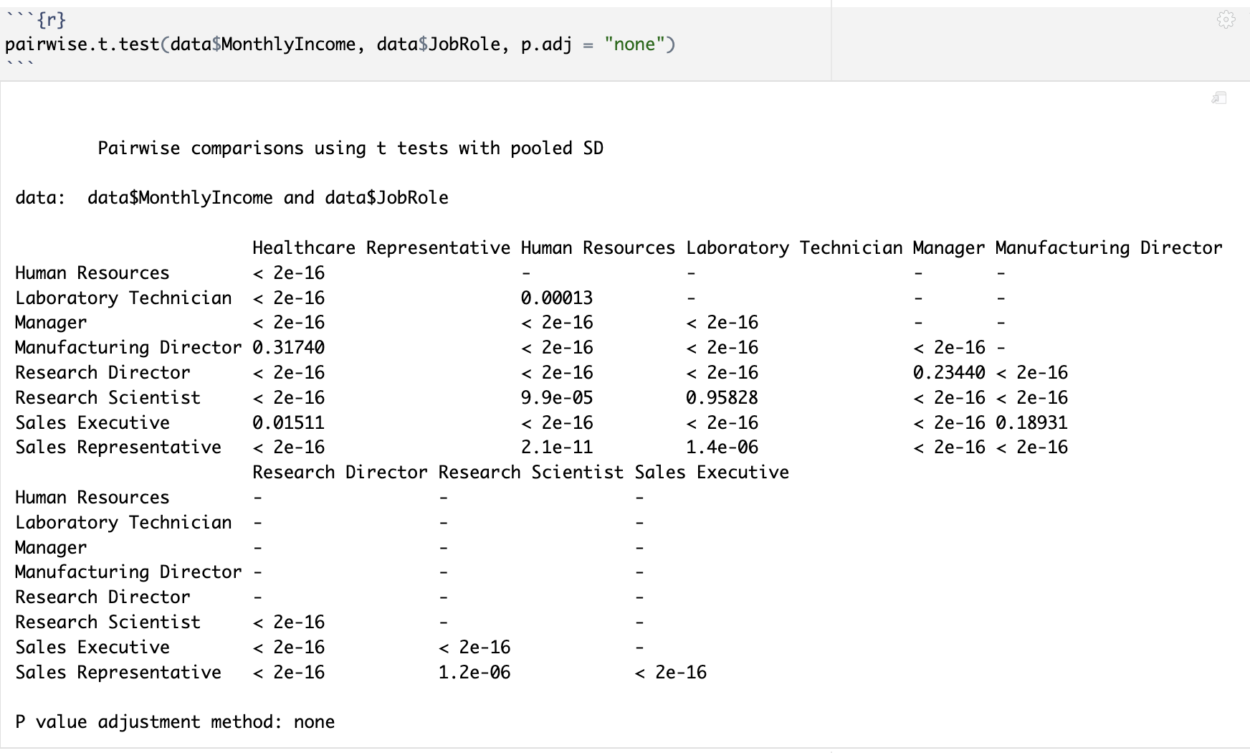
Pairwise t test
The outcomes from both the ANOVA and pairwise t-tests align with the F-statistic results, providing consistent evidence to confidently reject the null hypothesis. This strengthens our confidence in the observed associations and underscores the robustness of the findings.

Slide 27
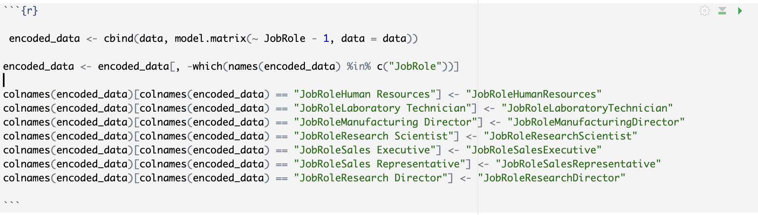
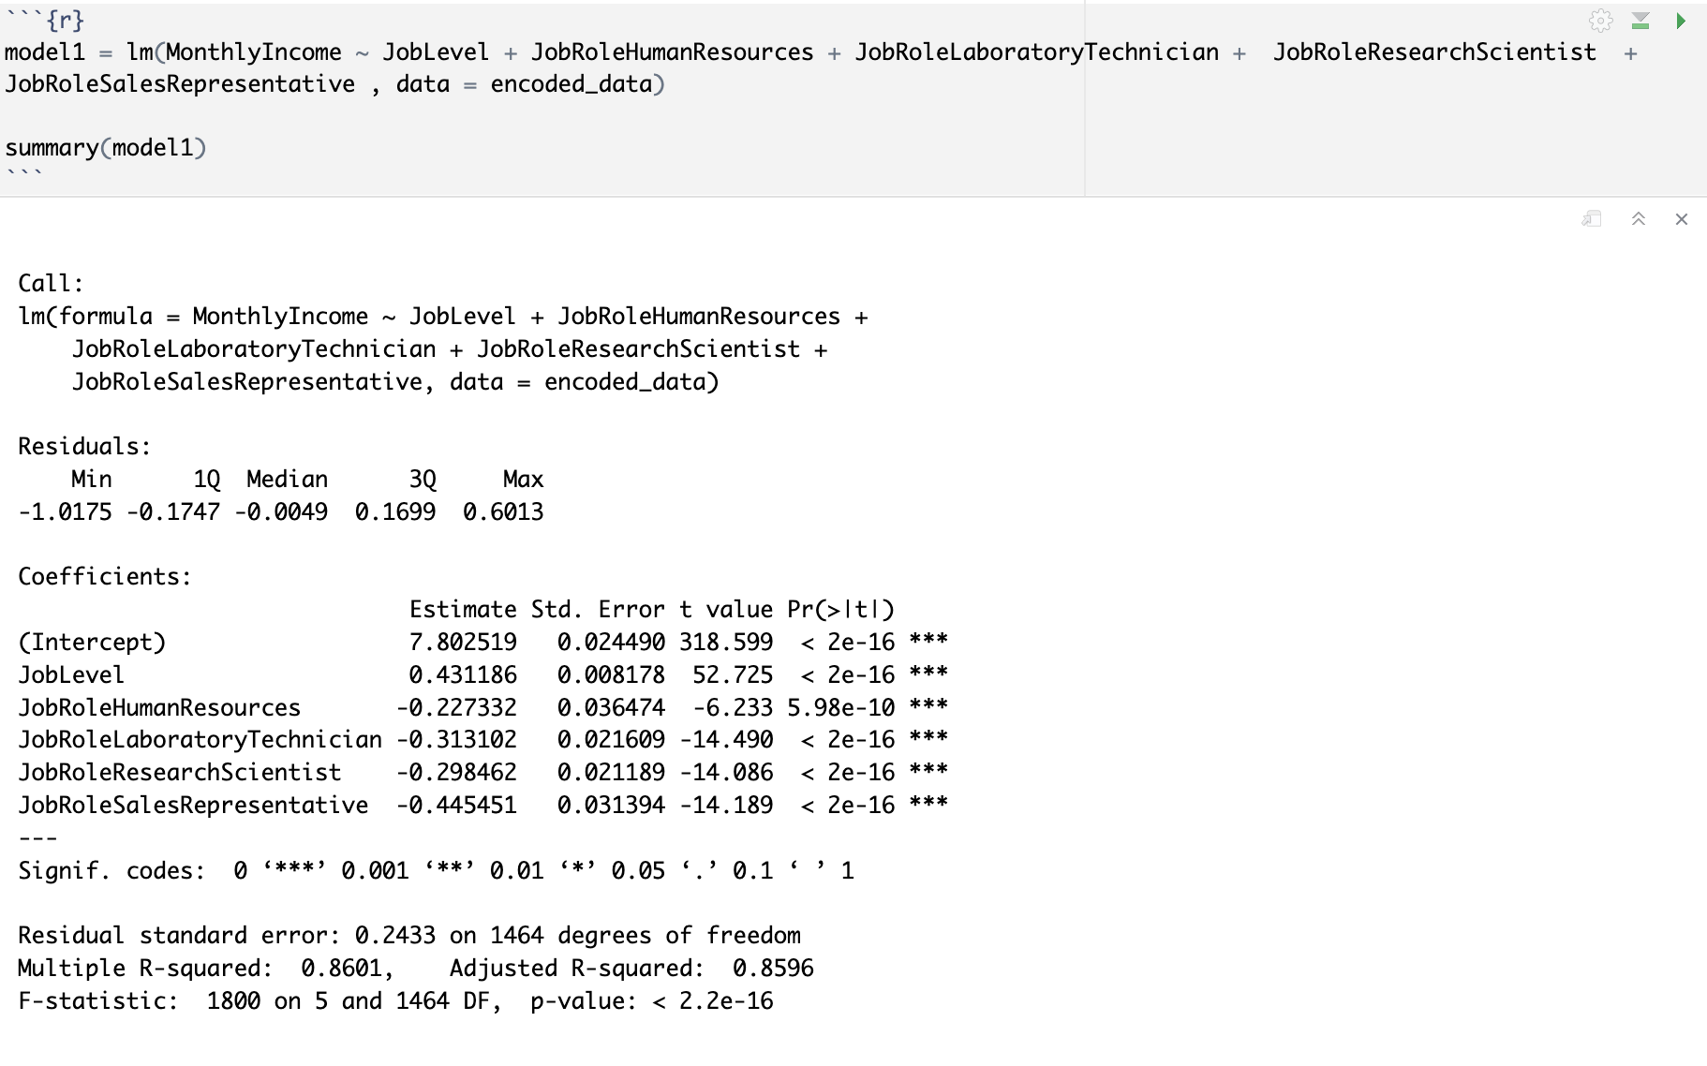
The above results indicate that not all categories of the job role variable exhibit an association with the response variable. Since individual categories of a categorical variable cannot be dropped outright, we opted to perform encoding to separate these variables. Subsequently, we reran the model to assess the adjusted R2, providing a more nuanced evaluation of the variable associations.
Equation: Monthly income = 7.802 + 0.431 (Job Level) - 0.227 (JobRoleHumanResources) -0.313(JobRoleLaboratoryTechnician)- 0.298(JobRoleResearchScientist) -0.445 (JobRoleSalesRepresentative).

Slide 28
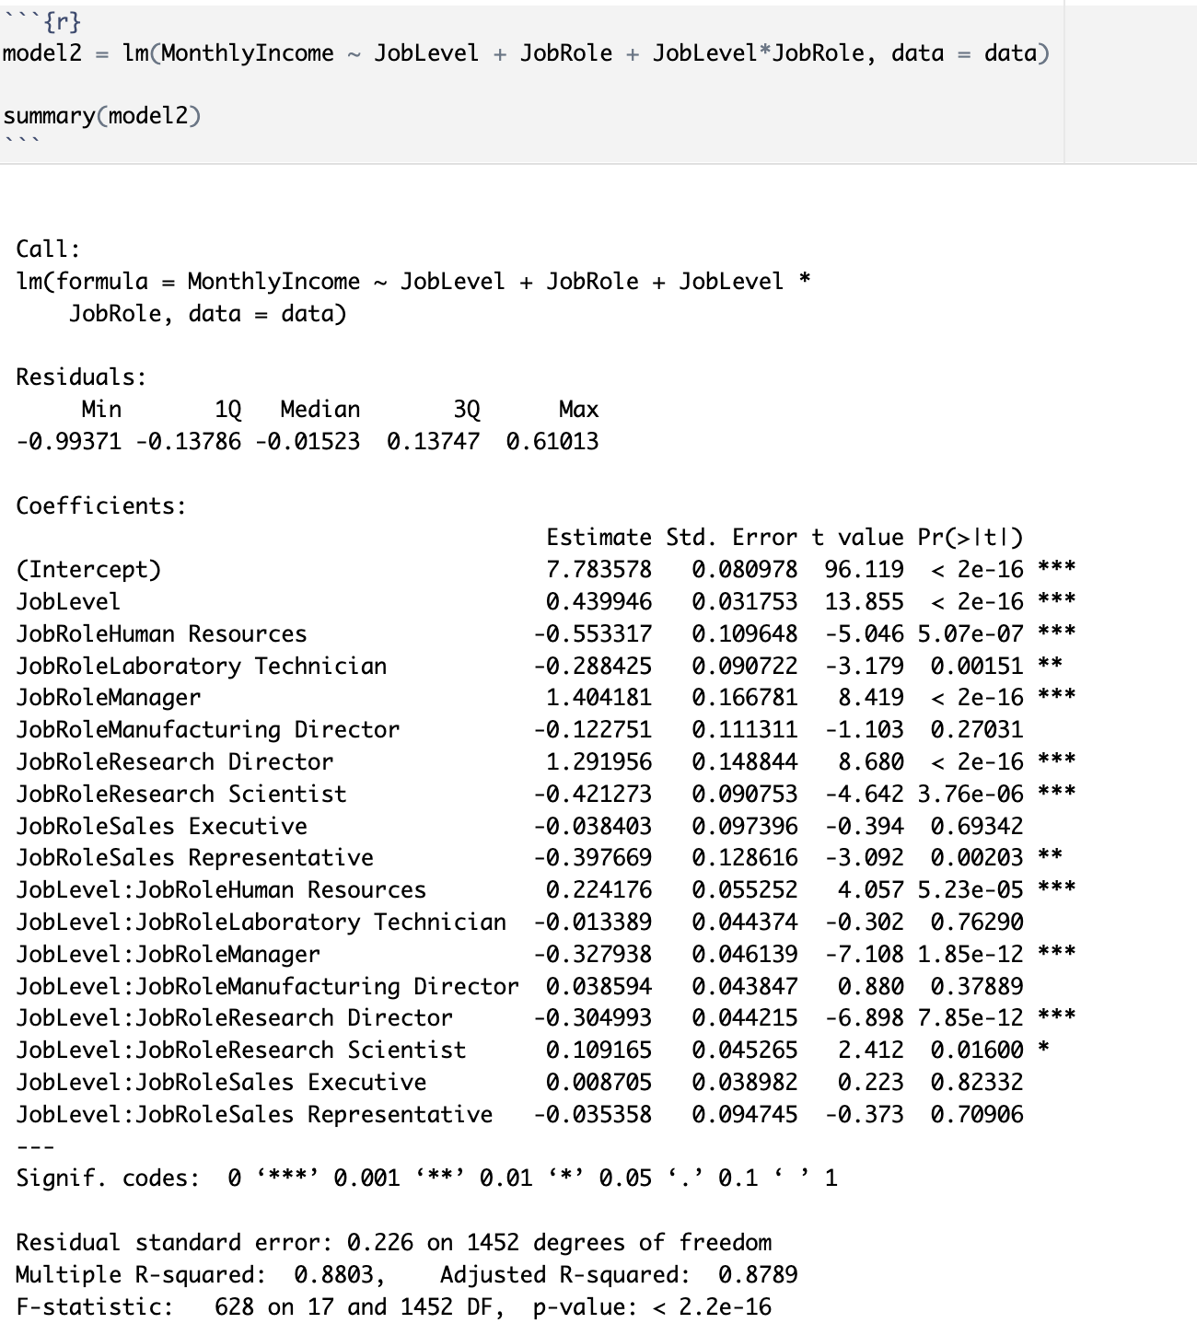
We obtained a conclusive adjusted R2 value of 0.8596, signifying a robust model fit. The variables demonstrating significant associations with the response variable, monthly income, were identified.
To further explore adjusted R2 changes, we conducted interactions with the predictors, examining their effects on the response variable. This additional step allowed us to gauge how the interplay between predictors influences the overall model performance and its explanatory power.

Slide 29
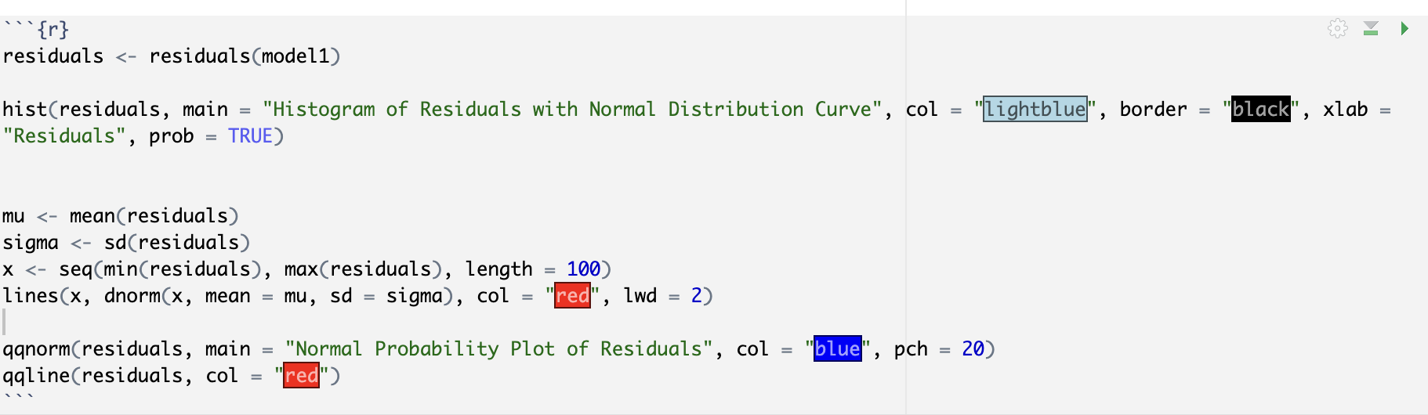
Despite the increase in the adjusted R2 value, it became apparent that numerous additional variables lacking statistical significance were contributing to the overall R2 value. Consequently, we concluded that the introduced interactions had a limited impact on the R2 value, indicating that the associated variables did not significantly enhance the explanatory power of the model.
We examined the assumptions of multiple linear regression, focusing on the normality of residuals and constant variability of residuals.
Normality of the residuals:

Slide 30
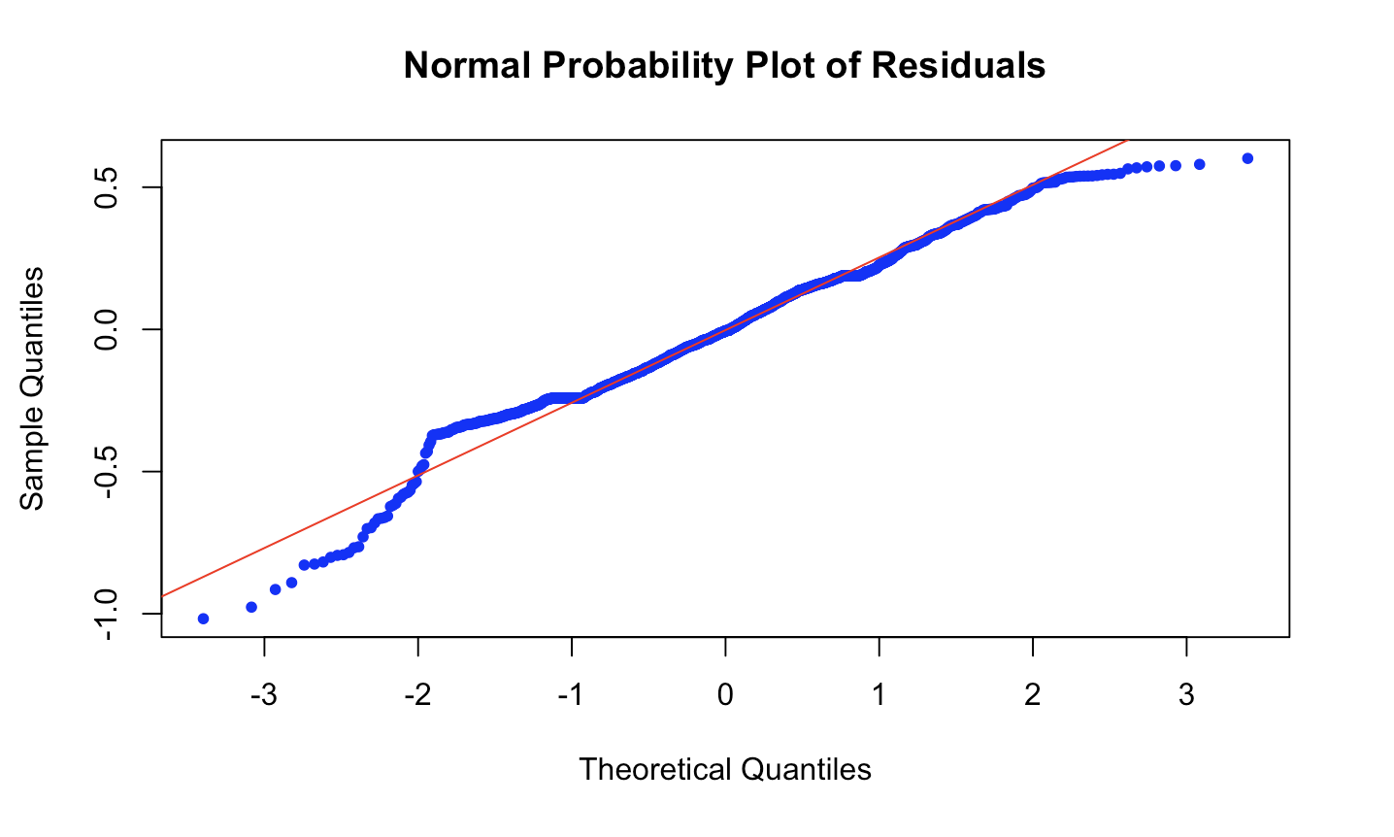
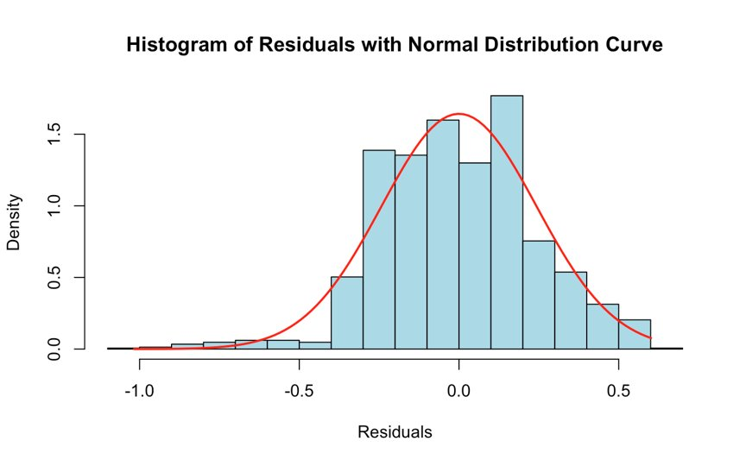
Both indicate that the residuals adhere to the normal density pattern within the central range, but the fit is less optimal in the tails, characterized by a notable presence of large positive and negative values among the residuals.

Slide 31
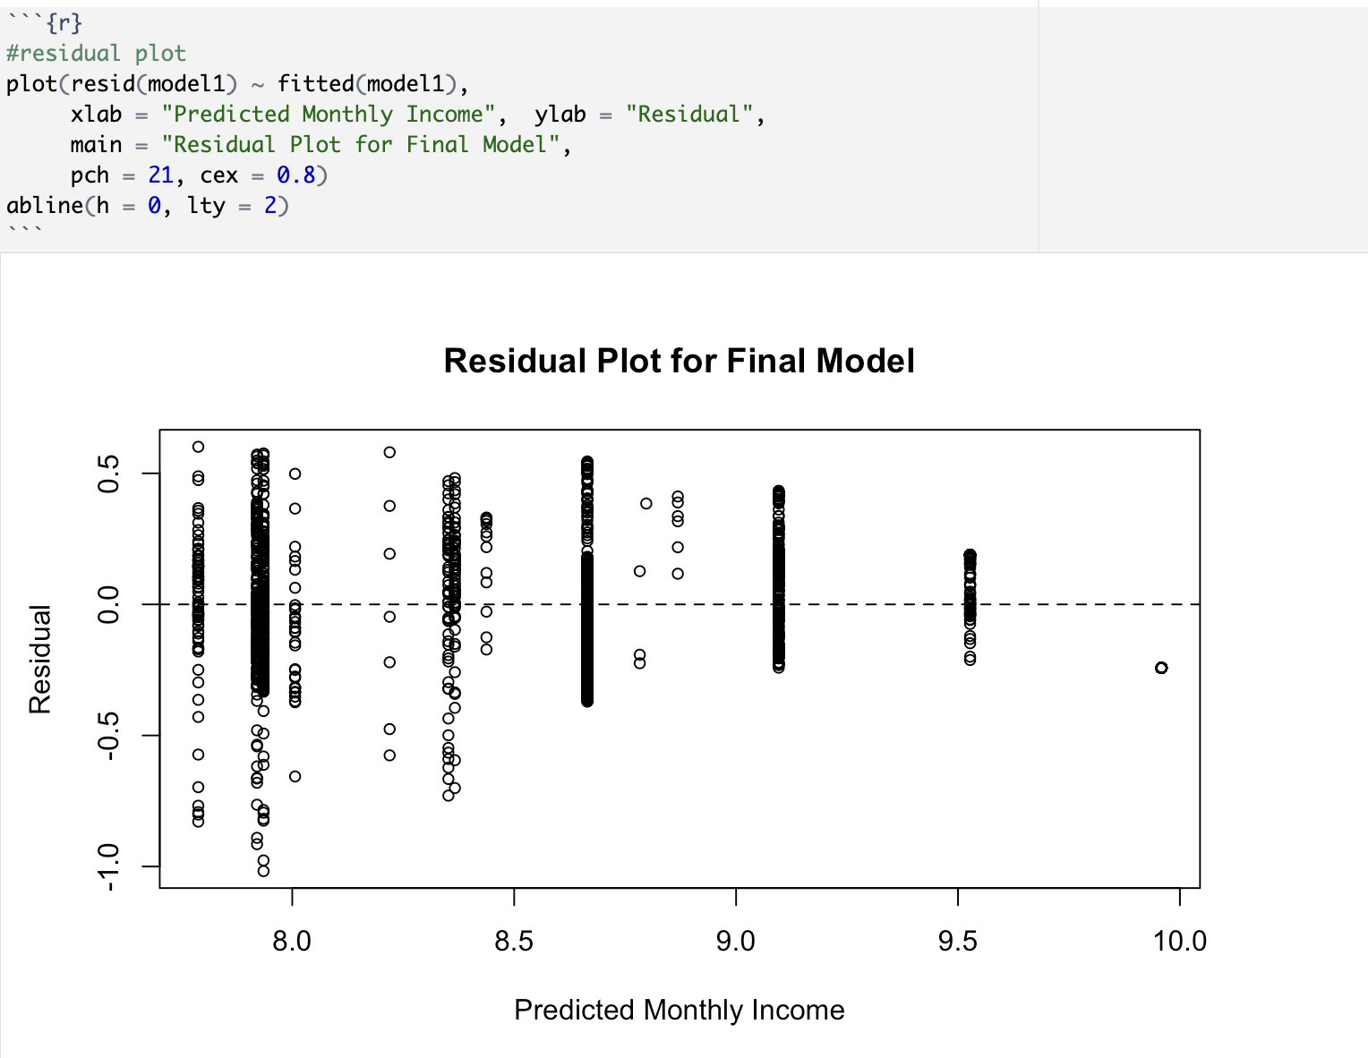
Constant variability is observed to be lower for higher values, suggesting that the model is not well-suited for accurately predicting the values.

Slide 32
Conclusion to RQ1
We reject the null hypothesis and state that there is a significant relationship between employee salaries and variables such job level, and department, allowing us to predict salaries effectively.
The adjusted R2 value of 0.86 in the ultimate model suggests that a significant portion of the observed variability in monthly income can be explained by job level and specific job roles. Among the measured features, job level and certain job roles (Human resources, Laboratory technician, Research scientist, Sales representative) exhibit the significant associations with monthly income.
An increase in job level is correlated with a rise in monthly income; specifically, when job roles remain constant, the model predicts an average monthly income increase of 0.43 for every one-unit elevation in job level, holding other variables constant.
However, despite these associations, the residual plots hint at potential inaccuracies in the final model. It may be prudent to explore higher-order models for a more refined understanding.

Slide 33
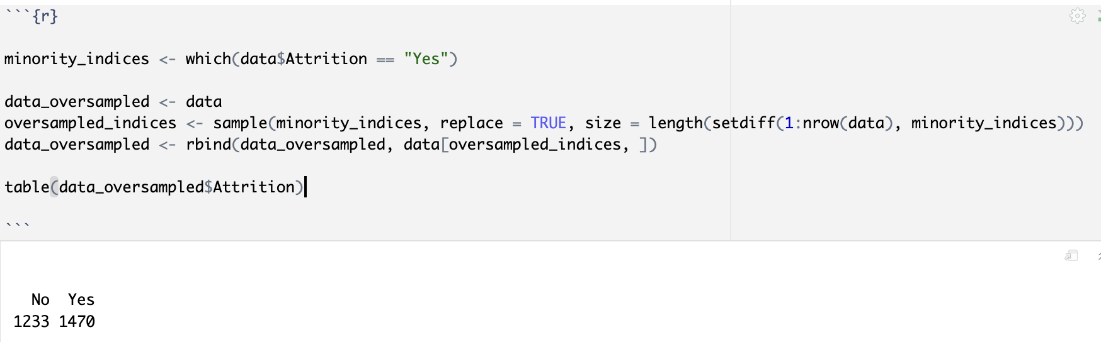
Multiple Logistic Regression
In response to the second research question, logistic regression was conducted, with attrition serving as the response variable and the remaining variables acting as predictors.
Prior to executing logistic regression, we identified class imbalance within the response variable. Consequently, oversampling was carried out to address this imbalance in the context of a binary classification problem.

Slide 34
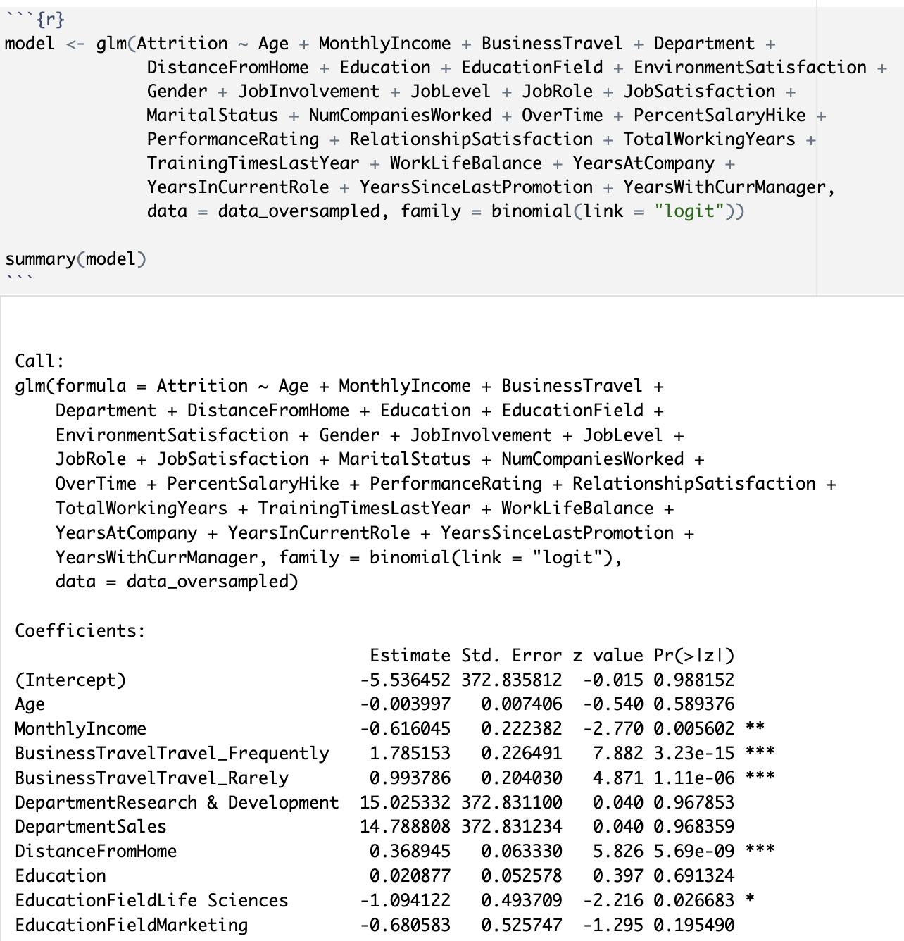
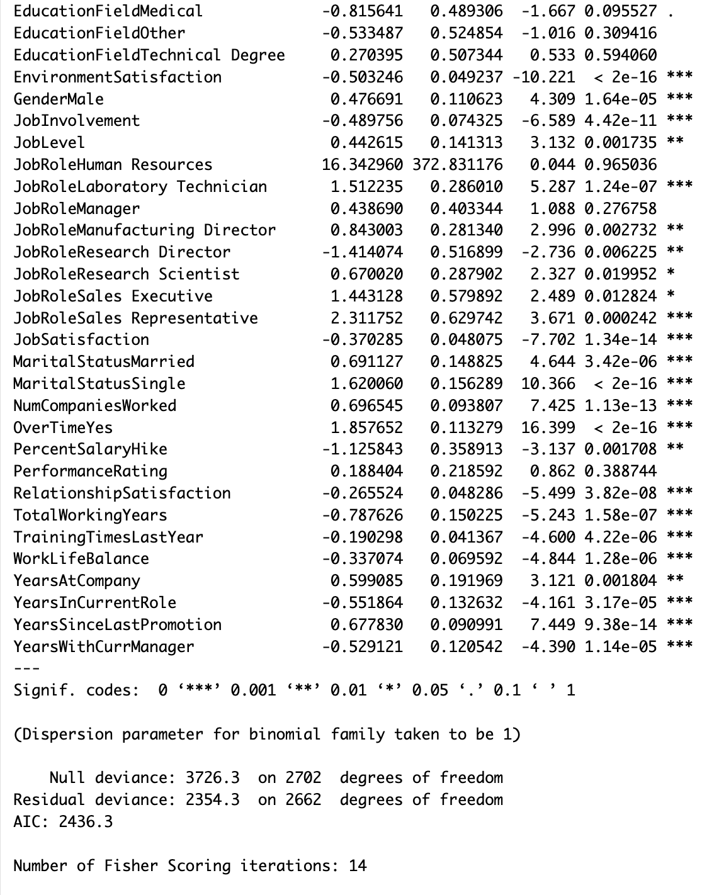
We observed most of the predictors have a significant association with the response variable.
Conclusion to RQ2: We reject the null hypothesis and state that there is a significant relationship between job-related factors (job level, department, job satisfaction) and employee attrition within the company.

Slide 35
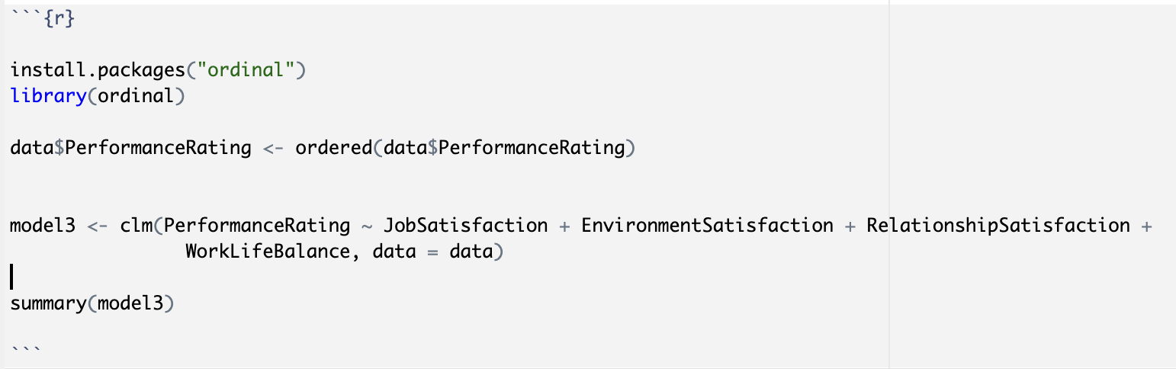
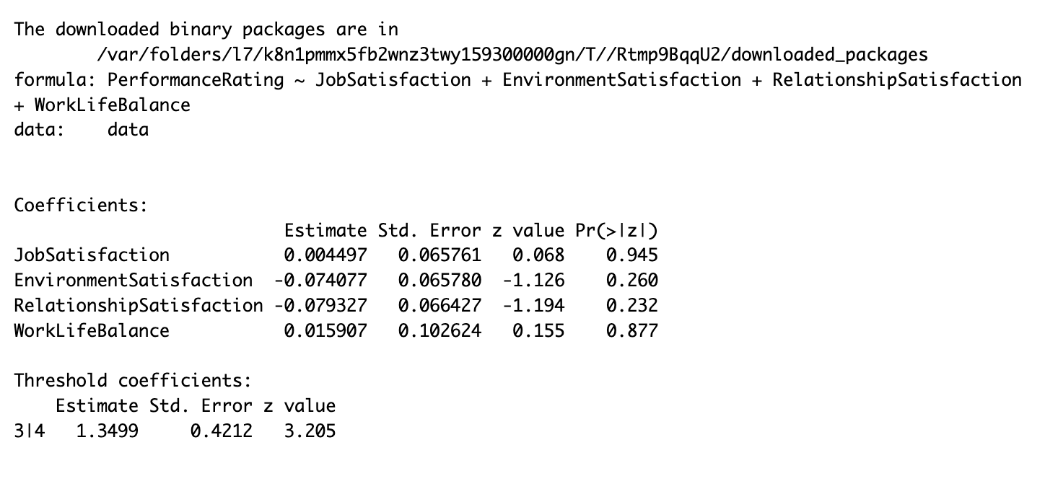
Ordinary Least Squares regression
In accordance with the third research question, we performed the association between performance ratings (the response variable) and specific predictors.
As none of the selected predictors have a significant association with the response variable. We decided to rerun the model with almost all the predictors.

Slide 36
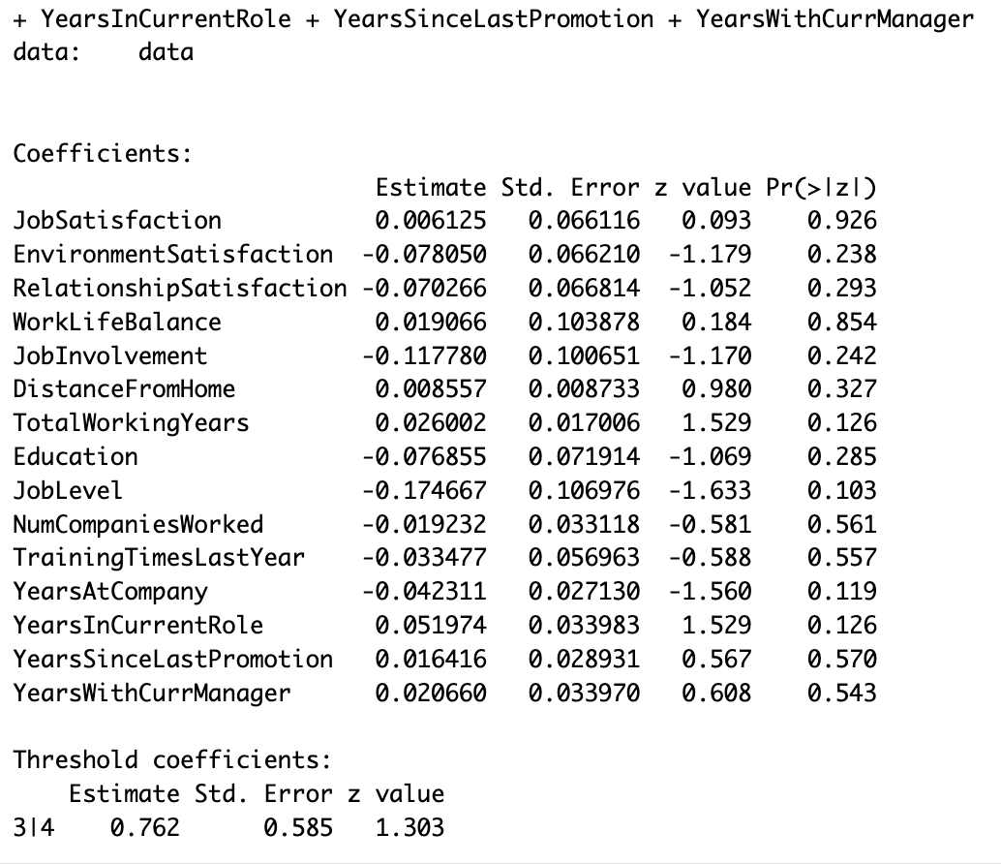
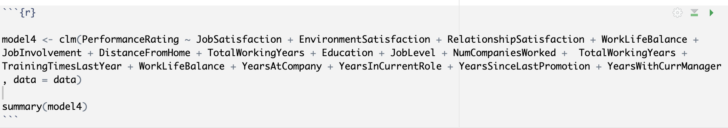
None of the predictors have shown significant association with the response variable.
Notes:
rerunning the model with all the predictors also didnt show any significant association with the dependant variable i.e perfor,asnce rating

Slide 37
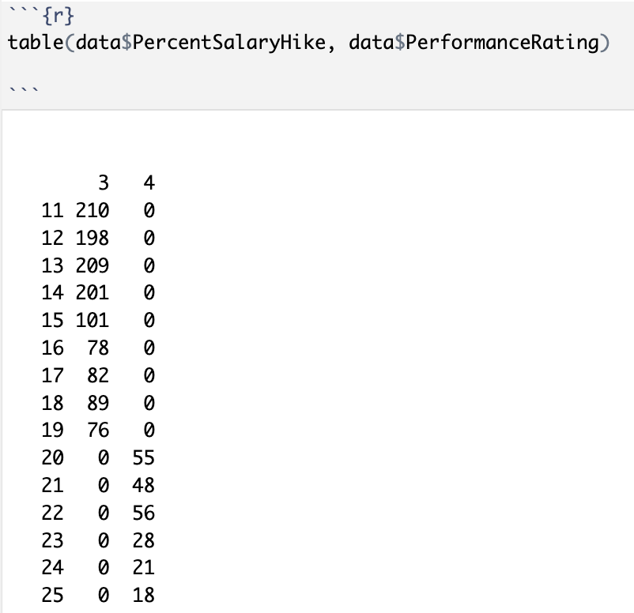
Upon reviewing the correlation heatmap, we opted to explore the relationship between percent salary hike and performance rating, given their robust positive association (r = 0.77).
However, when we executed the model for percent salary hike and performance rating, we encountered a scenario where the maximum likelihood estimates of the coefficients became infinite due to quasi-complete separation.
This arises from the observation that, for values of PercentSalaryHike less than or equal to 20, all instances exhibit a PerformanceRating equal to 4. This condition, known as quasi complete separation, which poses challenges in regression analysis
Notes:
as none of the independant variables shows significant association we examined the heatmap and identified that percentage salary hike is strongly corelated with the dependant variable i.e performance rating so we decided to run the model keeping performance rating as independent variable as we can visualise from the screenshot that

Slide 38
Conclusion to RQ3
We fail to reject the null hypothesis i.e.) there is no significant relationship between environment satisfaction, job satisfaction, relationship satisfaction, work-life balance, and performance ratings.
In addressing this issue, it's advisable to avoid using the Ordinary Least Squares (OLS) regression model, as it is not well-suited for situations involving quasi-complete separation. Consider alternative modeling approaches, such as logistic regression with regularization techniques (e.g., Firth's penalized likelihood) or other robust methods that handle separation issues more effectively.
Notes:
due to quassi compleet seperation it s not advisable to use ols .

Slide 39
Limitations
1. Causation and Correlation Distinction:
Statistical methods excel in identifying correlations between variables but lack the capacity to establish causation.
Correlations, as seen between job role, job level do not inherently indicate a causal link resulting in increased/decreased monthly income.
2. Impact of Confounding Variables:
Confounding variables, correlated with both independent and dependent variables, can introduce distortions into statistical results.
3. Influence of Biased Data:
The accuracy of statistical analyses hinges on the quality of the data used.
Biased or incomplete data may yield results that do not faithfully represent the true relationship between variables.
4. Predictive Limitations at Extremes:
Making predictions for values of the explanatory variable slightly larger than the minimum or smaller than the maximum can be precarious.
Sparse observations near the minimum or maximum values of the explanatory variable in many datasets may compromise the reliability of predictions in these extreme ranges.

Slide 40
References
Alblihed, M. A., & Alzghaibi, H. A. (2022). The Impact of Job Stress, Role Ambiguity and Work–Life Imbalance on Turnover Intention during COVID-19: A Case Study of Frontline Health Workers in Saudi Arabia. International Journal of Environmental Research and Public Health, 19(20), 13132. https://doi.org/10.3390/ijerph192013132
Balushi, A. K. A., Thumiki, V. R. R., Nawaz, N., Jurčić, A., & Gajenderan, V. (2022). Role of organizational commitment in career growth and turnover intention in public sector of Oman. PLOS ONE, 17(5), e0265535. https://doi.org/10.1371/journal.pone.0265535
Patel, P. (2018). Employee Attrition [Data set]. Kaggle. https://www.kaggle.com/datasets/patelprashant/employee- attrition/
Vu, J., & Harrington, D. (2020). Introductory statistics for the life and biomedical sciences. In Diez, D., Çetinkaya-Rundel, M., & Barr, C. (2019). OpenIntro Statistics. (1st ed., pp. 330-372 ). https://www.openintro.org/book/biostat/
Zhenjing, G., Chupradit, S., Ku, K. Y., Nassani, A. A., & Haffar, M. (2022). Impact of Employees’ workplace environment on Employees’ performance: A Multi-Mediation Model. Frontiers in Public Health, 10. https://doi.org/10.3389/fpubh.2022.890400

